Slide 1
AWS IAM

Slide 2
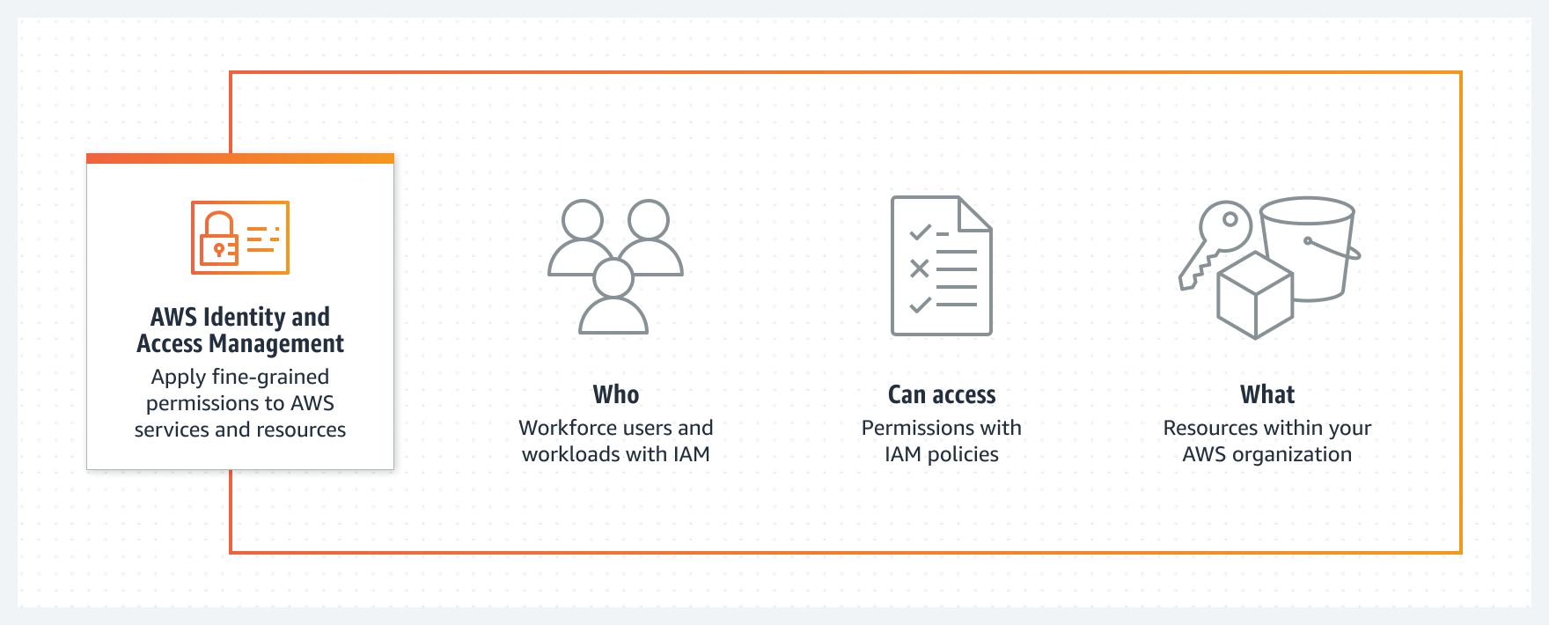
What is IAM?
Identity and Access Management

Slide 3
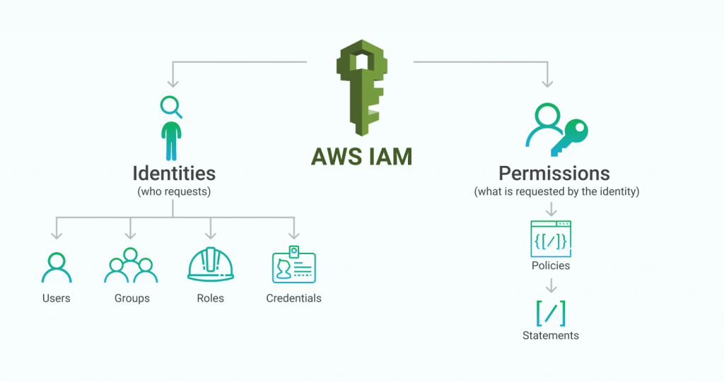

Slide 4
IAM Users and Groups
IAM = Identity and Access Management, Global service
• Root account created by default, shouldn’t be used or shared
• Users are people within your organization, and can be grouped
• Groups only contain users, not other groups
• Users don’t have to belong to a group, and user can belong to multiple groups

Slide 5
IAM Permissions
Users or Groups can be assigned JSON documents called policies
These policies define the permissions of the users
In AWS you apply the least privilege principle: don’t give more permissions than a user needs

Slide 6
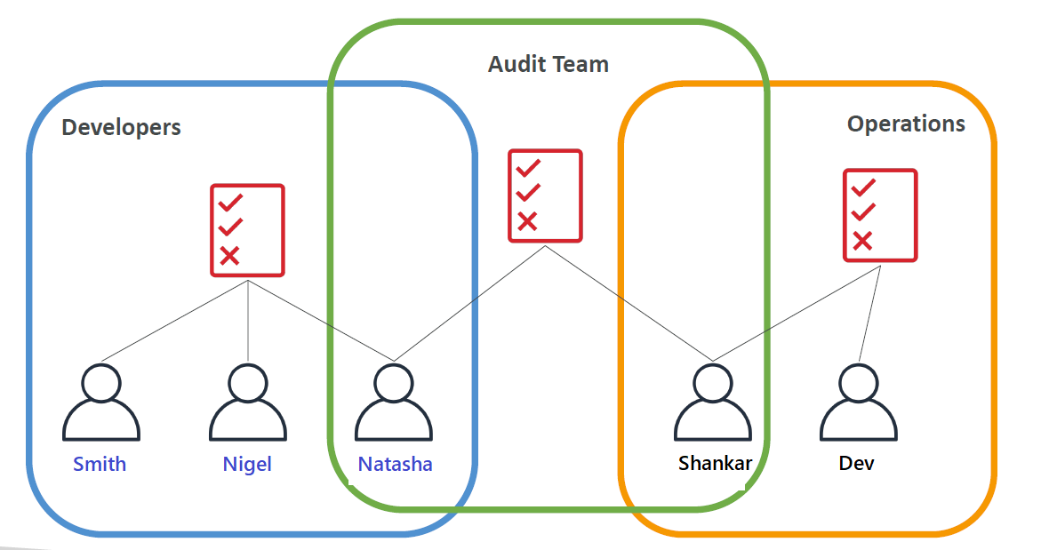
Policy Inheritance

Slide 7
Policy Structure Consists of
• Version: policy language version, always include “2012-10-17”
• Id: an identifier for the policy (optional)
• Statement: one or more individual statements (required)
Statements consists of
• Sid: an identifier for the statement (optional)
• Effect: whether the statement allows or denies access (Allow, Deny)
• Principal: account/user/role to which this policy applied to
• Action: list of actions this policy allows or denies
• Resource: list of resources to which the actions applied to
• Condition: conditions for when this policy is in effect (optional)

Slide 8
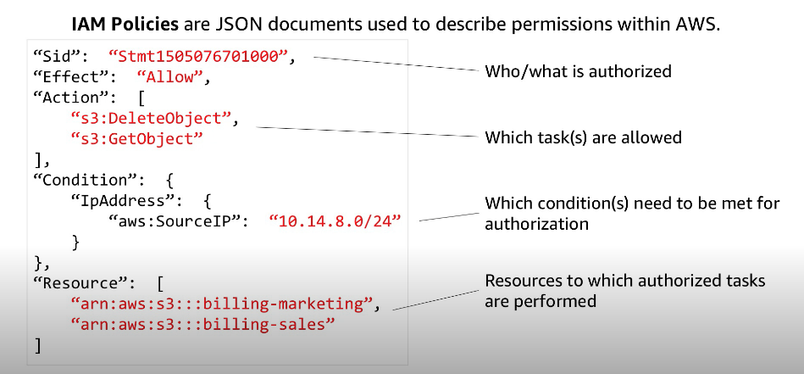

Slide 9
Password Policy
Set a minimum password length
• Require specific character types:
• including uppercase letters
• lowercase letters
• numbers
• non-alphanumeric characters
• Allow all IAM users to change their own passwords
• Require users to change their password after some time (password expiration)
• Prevent password re-use

Slide 10
Multi factor Authentication
Users have access to your account and can possibly change
configurations or delete resources in your AWS account
• You want to protect your Root Accounts and IAM users
• MFA = password you know + security device you own
• Main benefit of MFA:
if a password is stolen or hacked, the account is not compromised

Slide 11
How users can access AWS?
To access AWS, you have three options:
• AWS Management Console (protected by password + MFA)
• AWS Command Line Interface (CLI): protected by access keys
• AWS Software Developer Kit (SDK) - for code: protected by access keys
• Access Keys are generated through the AWS Console
• Users manage their own access keys
• Access Keys are secret, just like a password. Don’t share them
• Access Key ID ~= username
• Secret Access Key ~= password

Slide 12
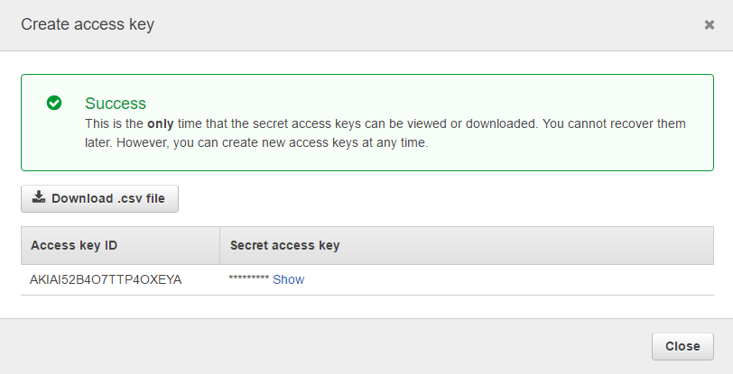

Slide 13
AWS Command Line Interface (AWS CLI)
A tool that enables you to interact with AWS services using commands in your command-line shell
• Direct access to the public APIs of AWS services
• You can develop scripts to manage your resources
• It’s open-source https://github.com/aws/aws-cli
• Alternative to using AWS Management Console

Slide 14
AWS Software Development Kit (AWS SDK)
Language-specific APIs (set of libraries)
• Enables you to access and manage AWS services
programmatically
• Embedded within your application
• Supports
• SDKs (JavaScript, Python, PHP, .NET, Ruby, Java, Go, Node.js,
C++)
• Mobile SDKs (Android, iOS, …)
• IoT Device SDKs (Embedded C, Arduino, …)
• Example: AWS CLI is built on AWS SDK for Java

Slide 15
IAM Roles for Services
Some AWS service will need to perform actions on your behalf
• To do so, we will assign permissions to AWS services with IAM Roles
Common roles:
• EC2 Instance Roles
• Lambda Function Roles
• Roles for CloudFormation

Slide 16
IAM Security tools
IAM Credentials Report (account-level)
• a report that lists all your account's users and the status of their various
credentials
IAM Access Advisor (user-level)
• Access advisor shows the service permissions granted to a user and when those
services were last accessed.
• You can use this information to revise your policies.

Slide 17
Best Practices
Don’t use the root account except for AWS account setup
• One physical user = One AWS user
• Assign users to groups and assign permissions to groups
• Create a strong password policy
• Use and enforce the use of Multi Factor Authentication (MFA)
• Create and use Roles for giving permissions to AWS services
• Use Access Keys for Programmatic Access (CLI / SDK)
• Audit permissions of your account using IAM Credentials Report & IAM
Access Advisor
• Never share IAM users & Access Keys

Slide 18
Users: mapped to a physical user, has a password for AWS Console
Groups: contains users only
Policies: JSON document that outlines permissions for users or groups
Roles: for EC2 instances or AWS services
Security: MFA + Password Policy
AWS CLI: manage your AWS services using the command-line
AWS SDK: manage your AWS services using a programming language
Access Keys: access AWS using the CLI or SDK
Audit: IAM Credential Reports & IAM Access Advisor

